Slide 1


Security - The world of IoT
Pavel Genevski, Research Expert @ SAP Labs Bulgaria April, 2017

Slide 2
Agenda
Security refresher
Why security?
Vocabulary building & discussion
Thread modeling exercise
Business case -> security architecture
Evaluation -> Mitigation
Some tools of the trade
Oscilloscope, Signal analyzer ….
Exercises

Slide 3
Security refresher

Slide 4
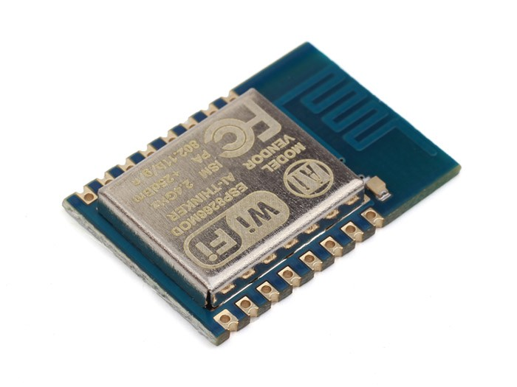
Why security (major goals)?
Authentication
Who is it (credentials)?
Confidentiality
Intended recipients only
Integrity
Data was not manipulated in transit
Authorization
Intended actors only
Anonymity
Authenticating without knowing the subject
System
Threat actor
Baby image from https://clipartfest.com/
Notes:
http://www.netanimations.net/animated-baby-looks-then-cries.gif
https://img.clipartfest.com/e1957816a1387eeb84ad8faba6156b46_animated-baby-looks-at-you-animated-crying-baby-clipart_198-198.gif

Slide 5
Vocabulary building
Availability, access control, ACL, audit, DoS, DDoS, Backdoor, BASIC, Block Cipher, Stream Cipher, Botnet, Brute force, Buffer overflow, Cleartext/Ciphertext, Compression bomb, Disaster recovery (MTTR, RPO), DES, AES, RSA, Diffie-Hellman,, Dictionary attack, PKI, x509, Disaster recovery plan, Domain hijacking, Eavesdropping, Escrow passwords, Fingerprinting, Hash, Hijacking (click, session …), Honey client/monkey, Honeypot, Inference attack, Intrusion detection, Flooding, Least privilege, LDAP, Logic bomb,MITM, NAT,NIST (NVD), Network taps, Non-repudiation, Penetration testing, Phishing, Ping of death, Privilege escalation, Promiscuous Mode, PKI, Resource exhaustion, Reverse engineering, RBAC/RSBAC, SSH, SSL, SHA, SIGINT (COMINT, ELINT), HUMINT, IMINT, MASINT (signature), TECHINT (tech capabilities K-129/ SOSUS), OSINT, Signature, Smurf attack, Sniffing (passive wiretapping), Social engineering, Stealthing, SYN Flood, Tamper, Trojan horse, Trust, Threat vector, Web of trust, Zero Day, Zombie
Just kidding … ☺
Notes:
https://www.sans.org/security-resources/glossary-of-terms/
http://www.hamiltonproject.org/ee-ce-image/made/assets/img/uploads/charts/cost_of_computing_power_equal_to_an_ipad2_1017_685_80.jpg
https://en.wikipedia.org/wiki/Soviet_submarine_K-129_(1960)

Slide 6
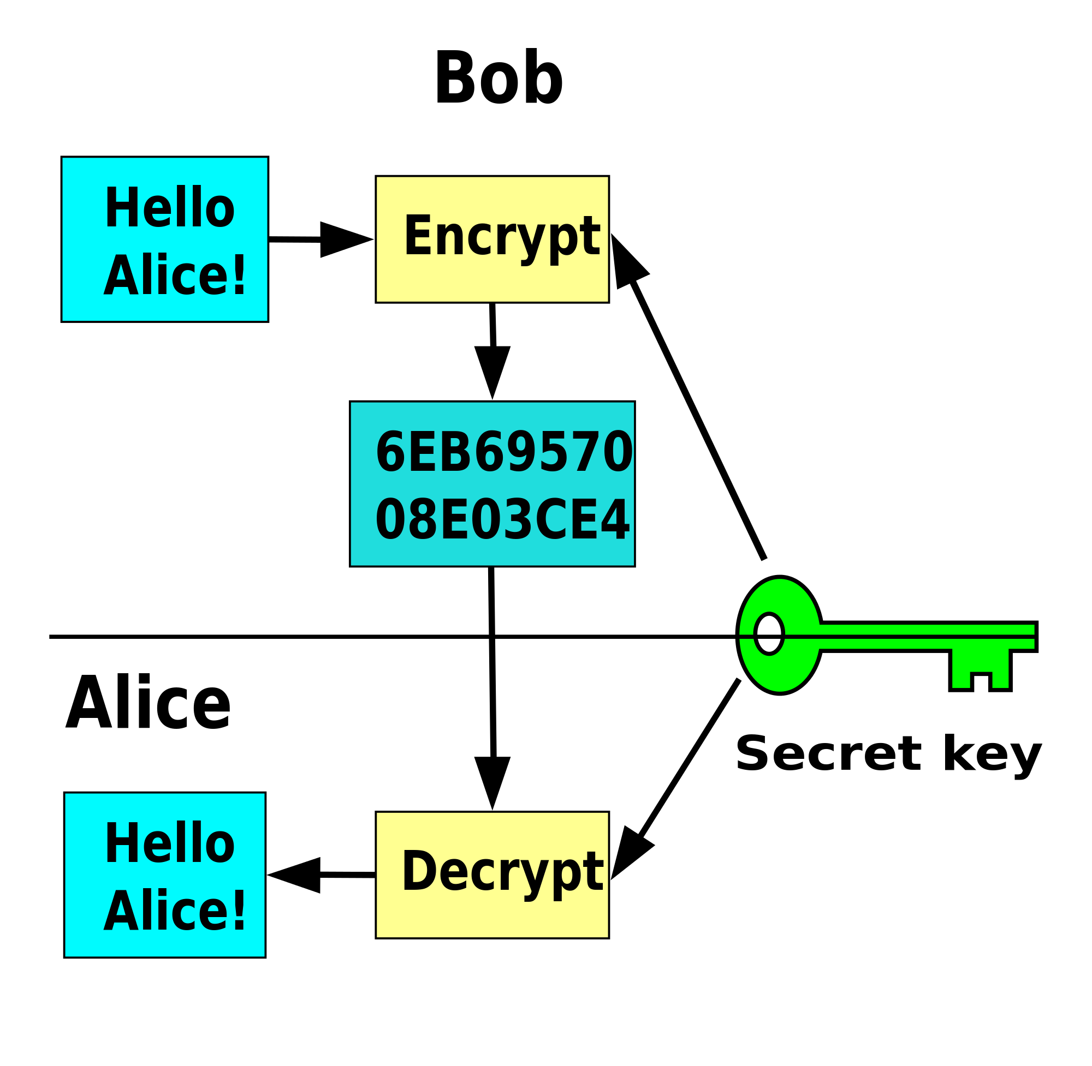
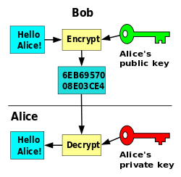
Glossary: Crypto
Hash
Data -> fingerprint
Examples: MD5, SHA, SHA3
Symmetric encryption
Data + key -> Cyphertext
Examples: AES, 3DES, Blowfish
Asymmetric (public key) encryption
Data + public key -> Cyphertext
Cyphertext + private key -> Data
Examples: RSA, Diffie-Hellman, DSA

Slide 7
Glossary: X509 certificates & PKI
Signature
Data(hash) + Private key -> Signature
Signature + Public key -> Data(hash)
X509
A format for public key certificate
Contains public key and identity
Signed (either by CA or self signed)
Revocation lists
PKI
Certificate authorities, Web of trust, Blockchain based …
Root CA
CRL
CA
CA

Slide 8
Threat modeling

Slide 9
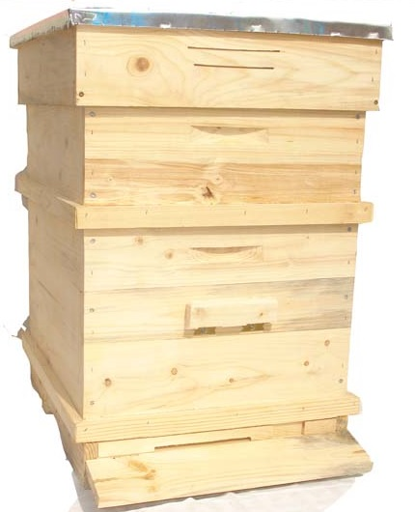
Threat modeling
Beekeeper
Goals
Go through the overall business case
Identify security weaknesses and requirements
Asses the risks: RISK = Probability * Impact
Plan mitigations:
Avoid: Software implementations/fixes, firewall rules …
Control: Create procedures, monitor and respond …
Transfer: insurance, outsourcing …
Accept: do nothing or spare some budget (auto insurance)
Deliverables
Risk report (P/I map)
Risk management plan
Web server
Staff
?
WiFi
Threat actor
Baby image from https://clipartfest.com/
Notes:
https://en.wikipedia.org/wiki/Risk_management_plan

Slide 10
Some tools of the trade

Slide 11
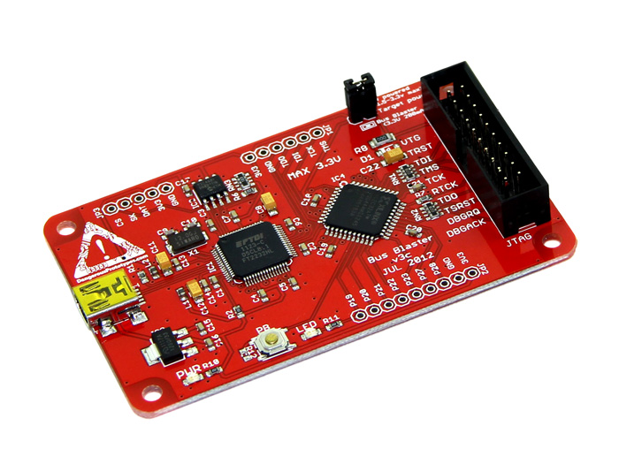
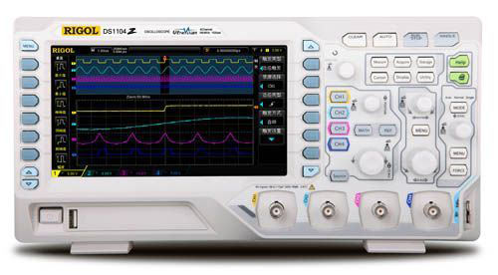
Some tools of the trade (hardware)
Logic analyzer
Acquire data
Decode common protocols (SPI, I2C, 1-wire …)
SDR ()
Acquire, analyze and synthesize radio signals
JTAG (e.g. Bus Blaster)
Debug on-board processors and chips
Reprogram
Oscilloscope
Visually inspect signals
Record and capture waveforms
Notes:
http://www.rigol.eu/images/products/DS1054Z.jpg
http://dangerousprototypes.com/docs/Bus_Blaster
https://research.kudelskisecurity.com/2014/05/01/jtag-debugging-made-easy-with-bus-pirate-and-openocd/

Slide 12




Some tools of the trade (software)
Network scanners
Analyze the network (Live hosts, open ports …)
Fingerprint (OS, software, version …)
Examples: nmap, masscan, Shodan.io …
Metasploit
Penetration testing
Database of exploits
WiFi & routers security
Analyze and attack WiFi: Kismet, Aircrack-NG
Routersploit: known router exploits
Notes:
https://www.kismetwireless.net/
http://www.aircrack-ng.org/
https://github.com/reverse-shell/routersploit
https://www.shodan.io/

Slide 13
Exercises

Slide 14
Exercises
Learn to use logic analyzer
Acquire data
Decode 1-wire (or some other protocol)
Make an HTTPS request with ESP8266…
Notes:
https://github.com/esp8266/Arduino/blob/master/libraries/ESP8266WiFi/examples/HTTPSRequest/HTTPSRequest.ino
https://github.com/esp8266/Arduino/blob/master/libraries/ESP8266WiFi/src/WiFiClientSecure.cpp
https://github.com/esp8266/Arduino/blob/master/libraries/ESP8266WiFi/src/WiFiClientSecure.h
https://github.com/esp8266/Arduino/issues/1743
https://github.com/esp8266/Arduino/issues/313
https://gist.github.com/9SQ/200c796672b0f4db173e
https://www.bountysource.com/issues/31027576-wificlientsecure-ssl-not-used-at-all

Slide 15
Thank you
Contact information:
Pavel Genevski
Research Expert
SAP Labs Bulgaria

Slide 18
The Grid
Headline area
White space
Drawing area

